Slide 1
Chatbot for HR Department
Using AIML & LSA
Ajaykumar Kushwaha 41
Rishikesh Nanaware 52
Damini Pandare 57
Date of presentation: 18/09/2020
Under the guidance of: Prof. Nileema Pathak
Prof. Odilia Gonsalves
Atharva College of Engineering
Department of Information Technology

Slide 2
Content
Introduction
Problem definition & Proposed solution
Scope of project
Review of literature
System description
Hardware & software requirements
User Interface Design
Test cases
Comparative Analysis
Results and Discussions
Conclusions
Future Scope
Literature Cited (book, web & paper References)
Publications by your group (if any)
Acknowledgements
Demo to be given

Slide 3
Introduction
In industry, users use database applications to get information related to employees. This needs knowledge about the database to non-technical employees such as the HR department. Other applications developed are not much user friendly and they are not smart enough to evolve on themselves and to understand what user actually wants. Other applications give programmed options restricting user to explore all aspects. The Chatbot for HR department aims to provide efficient and accurate answers for queries asked by HRs from the database using Artificial Intelligence Markup Language (AIML) and Latent Semantic Analysis (LSA). Chatbot for HR department will be able to answer questions, query results. Chatbot will be able to answer questions related to salary, attendance, product growth as well as it will give suggestions if it doesn't get proper answers for the user's query. Chatbot will have full HR data.

Slide 4
Problem definition & Proposed solution
Problem Definition:
Searching for details of employees in a huge database is a tedious and hectic task. Also, it is difficult to customize searches and results. User has to type various queries to get different results. The appearance of an application is not interactive.
Proposed Solution:
The proposed system developed a chatbot using technologies namely Artificial Intelligence Markup Language (AIML) and Latent Semantic Analysis (LSA). Chatbot makes the application more interactive and improves appearance. LSA finds out important texts from user-entered queries and AIML matches them with the templates stored. Once the query is matched response is generated by interacting with the database and returned to the user. If AIML does not have a matching template system again ask the user to re-enter the query. LSA makes it possible for the system to understand human entered queries giving user options to explore all aspects.

Slide 5
Scope of project
Chatbot will be able to answer questions based on attendance like getting the attendance of an employee at a particular company location. Chatbot gives response in various formats like text, tables, graphs, etc. This project can be further modified for other departments as this project only works for the HR department. Frontend can be improved to grab maximum attention of the user. The model can be trained to analyze data and then display results.

Slide 6
Review of literature
Sr.no | Title | Author | Publication | Approach
1 | Chatbot for University Related FAQs | Bhavika R. Ranoliya , Nidhi Raghuwanshi and Sanjay Singh | International Conference on Advances In Computing Communications and Informatics 2017 | They developed a interactive chatbot for University related Frequently Asked Questions (FAQs). User discussion as a rule begins with welcome or general questions. User inquiries are first taken care by AIML check piece to check whether entered inquiry is AIML script or not. AIML is characterized with general inquiries and welcome which is replied by utilizing AIML formats[1].
2 | Automated Thai-FAQ Chatbot using RNN-LSTM | Panitan Muangkammuen,Narong Intiruk ,Kanda Runapongsa Saikaew | 22nd International Computer Science and Engineering Conference 2018 | They proposed and developed a Frequently Asked Questions (FAQs) Chatbot which automatically responds to customers by using a Recurrent Neural Network (RNN) in the form of Long ShortTerm Memory (LSTM) for text classification[2].

Slide 7
3 | Intelligent Chatting Service Using AIML | Saqib G, Faizan , Ghatte N | IEEE International Conference on Current Trends toward Converging Technologies, 2018 | AIML limits the bots to perform mathematical calculations, provide information about weather, news, recent updates etc. This paper describes the development of chat bots hosting service. This hosting website also provide API’s for Weather, News, Dictionary, web encyclopedia, Mathematical Calculations and much more and a global file to keep all bots updated that are hosted on the website[3].

Slide 8
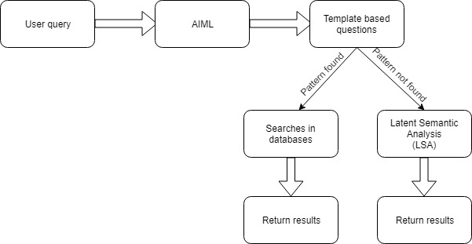
System description

Slide 9
Hardware & software requirements
Software Requirements:
1. AIML
2. LSA
3. Python 2.7
4. Django
Hardware Requirements:
1. Computer with minimum 4GB RAM

Slide 10
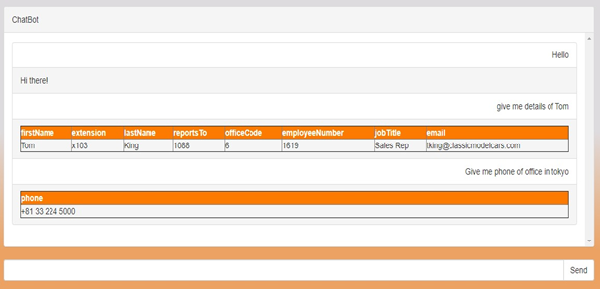
User Interface Design

Slide 11
Test cases
S No | Action | Inputs | Expected Output | Actual Output | Test Platform | Test Result | Test Comments
1. | Enter Template Based Message | Template Based Query | Set Response For Entered Query | Set Response For Entered Query | Windows OS, Chrome Version 79.0. | Pass | Expected Response Returned by Chatbot
2. | Enter Data Retrieval Query | Data Retrieval Query | Data Retrieved From Database Based on Input Query | Data Retrieved From Database Based on Input Query | Windows OS, Chrome Version 79.0. | Pass | Expected Data Reurned By Chatbot

Slide 12
3 | Enter query not related to employee | Random query | Chatbot asks to re-enter | Chatbot asks to re-enter | Windows OS, Chrome Version 79.0. | Pass | Expected action taken by chatbot.
4 | Enter non-related query three times | Non-related query | Chatbot understands what user wants and gives proper response | Chatbot understands what user wants and gives proper response | Windows OS, Chrome Version 79.0. | Pass | Expected action taken by chatbot.

Slide 13
Comparative Analysis
Languages | Extension/Platforms | Server Side Scripting | AIML Libraries | LSA Libraries
Python | Windows, Linux, Mac OS | Yes | Yes | Yes
Java | Windows, Linux, Mac OS | Yes | Yes | Yes
Ruby | Windows, Linux, Mac OS | Yes | Yes | No
C++ | Windows, Linux, Mac OS | Not recommended | Yes | Yes
PHP | Windows, Linux, Mac OS | Yes | Program O is an AIML interpreter written in PHP | Yes

Slide 14
Results and Discussions
Chatbot interacts with users giving responses in various forms like text, tables, graphs, etc. If chatbot does not understand the proper meaning of what the users want to ask it asks back users based on how many parts of it chatbot has understood. If a chatbot does not get a correct response it gives suggestions to the user.

Slide 15
Conclusions
This project will definitely simplify the work of the HR department by finding accurate answers to their questions. Chatbot developed will be continuously developing and learning from the data which is new to the system.

Slide 16
Future Scope
This project can be further modified for other departments as this project only works for the HR department. Frontend can be improved to grab maximum attention from the user. The model can be trained to analyze data and then display results.

Slide 17
Literature Cited
1] “Chatbot for University Related FAQs”, Bhavika R. Ranoliya ,NidhiRaghuwanshi and Sanjay Singh, International Conference on Advances In Computing Communications and Informatics 2017
2] “Automated Thai-FAQ Chatbot using RNN-LSTM”, PanitanMuangkammuen, NarongIntiruk ,Kanda RunapongsaSaikaew , 22 nd International Computer Science and Engineering Conference 2018
3] “Intelligent Chatting Service Using AIML”,Saqib G, Faizan , Ghatte N , IEEE International Conference on Current Trends toward ConvergingTechnologies, 2018

Slide 18
Publications
International Research Journal of Engineering and Technology (IRJET) Volume 7, Issue 3, March 2020 https://www.irjet.net/volume7-issue3 S.NO: 428
https://www.irjet.net/archives/V7/i3/IRJET-V7I3428.pdf

Slide 19
Acknowledgements
We have the great pleasure of presenting our report on our project "Chatbot for HR-Department". We take this opportunity to express our sincere gratitude towards our guide Prof. Nileema Pathak and co-guide Prof. Odilia Gonsalves for providing the technical guidelines and suggestions regarding the line of this work. We would like to thank them for their constant encouragement, support, and guidance throughout the development of the project. We are also thankful to Dr. S. P. Kallurkar (Principal) and Prof Deepali Maste (Head of Department ) without their support and advice our project would not have shaped up as it has. We also wish to express our deep gratitude towards our colleagues at ACE, Mumbai for their encouragement.

Slide 20
Questions??
Thank You!

